Slide 1
SmartPlant 3D Common Task

Slide 2
Agenda
SmartPlant Overview
User Interface
View Manipulation
Workspace
Filters
Work Breakdown Structure (WBS)
Tooltips
Control Point / Notes
Measure
Interference Detection (IFC)
To Do List

Slide 3
SmartPlant 3D Overview
  SP3D is a collection of number of applications/tasks
User Applications
Drawing
Hanger/Supports
Structure
Route Apps
Interference
Geometry
Topology
CommonApp & Project Management
Catalog Data
Equipment
ACIS
SP3D CORE
ACIS is a library of “functions” that address:
  Wire-frame Modeling
  Surface Modeling
SP3D Geometry/Topology Provides
COM Interface to ACIS

Slide 4
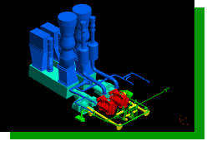
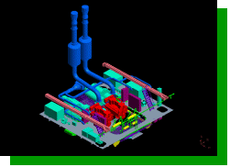
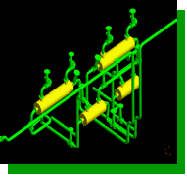
Single Database
SYSTEM
File boundaries inhibit
access to data.
SYSTEM
Single
Logical
Database
CAD
File
CAD
File
CAD
File
CAD
File
CAD
File
CAD
File
CAD
File
CAD
File
CAD
File
CAD
File
CAD
File
CAD
File
CAD
File
CAD
File
CAD
File
CAD
File
CAD
File
CAD
File
CAD
File
SPACE
ASSEMBLY
SPACE
ASSEMBLY
Databases provide easy access to
arbitrary subsets of data.

Slide 5
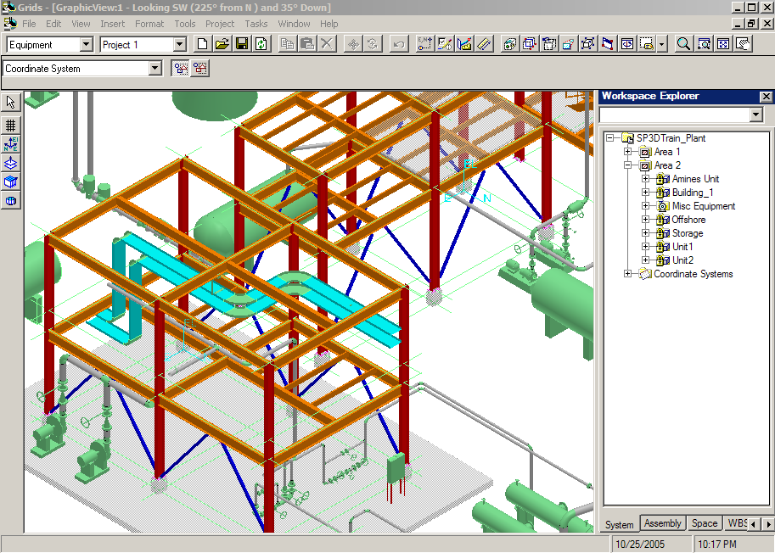
Common Windows Based User Interface
SmartPlant “Task” Oriented Interface
Common Windows Interface
Ribbon Bars
Graphic Views
Main Menu
Access
Control
Common Toolbar
Workspace
Explorer
Active
command Ribbon bar
Task Toolbar
Active View
Status Bar

Slide 6

Query
Where did my design file go?
Define Workspace (filter on database):
See only the data you want to see
Builds a logical “Working Set”
  System
  Assembly
  Spatial (Volume or Planes)
  Logical Permission Group
  Object Types/Properties
Saved Session Files
Report Database set
Workspace
Model Database
Site Database set
Catalog Database set
Display

Slide 7
SmartStep Commands
Same task specific ribbon bars for placement and object-action modify commands
SmartSteps
Active Properties
Data Fields

Slide 8
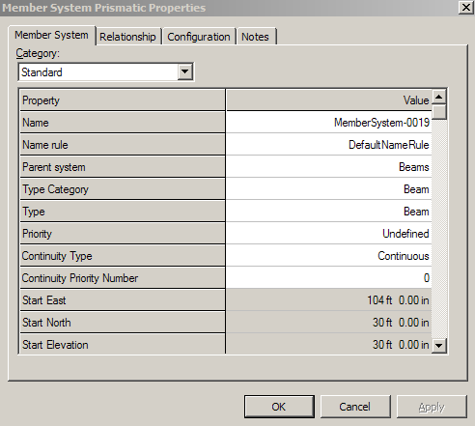
SmartStep Commands
Property Dialogs
  Same properties interface available for place/modify
Tabbed Dialogs
Edit Controls

Slide 9
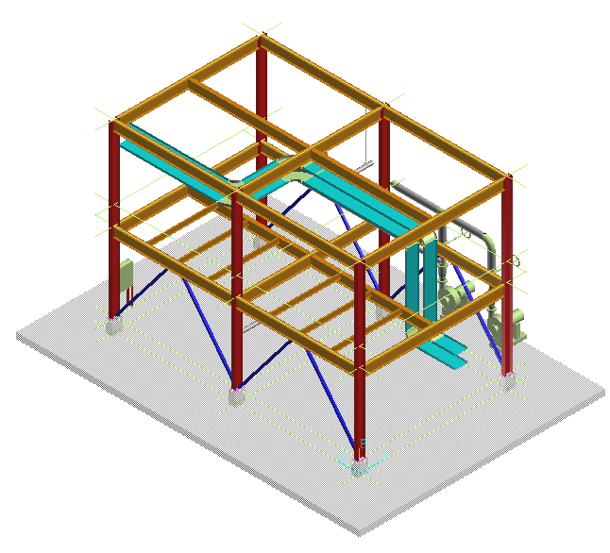
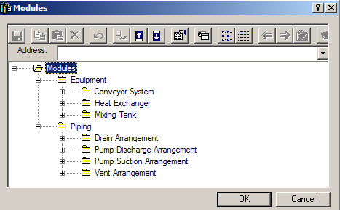
Design Re-use
Copy to Catalog
or
Instance in Another Location
Unit1
Internal Relationships Maintained.
External Relationship Exposed.

Slide 10
Rules Services
Interference Checking
  Clash and Design Rules
  Server
    Production check
  Client
    Simple / dynamic
    No database record
LOCAL
APPLICATION
LOCAL
RULES
ANALYSIS
UPDATE
DESIGN
CHANGES
PERIODIC
REFRESH
DISPLAY
PERIODIC
QUERY
CHANGES
DATABASE
SERVER-BASED
RULES ANALYSIS
UPDATE
RESULTS

Slide 11
Common Task
Provide common functionality for all SP3D User Environment:
  Session Management
  Common Environment
  Viewing Commands
  General Options/SmartSketch 3D
  Aspects/Surface Styles/Rules
  Show/Hide
  Measure
  Interference Checking

Slide 12
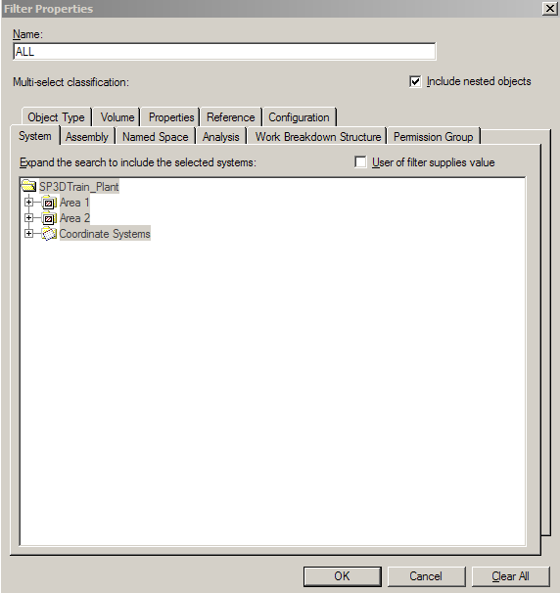
Session Management
Session Templates
Store option settings such as task list,
window views, orientations,
Background colors, graphics views, etc
Filter
A set of search criteria that define a
query to the model database
Workspace/Session =
Session Template + Filter
DB2
DB1
DB3
Workspace
See only the data you want to see.

Slide 13
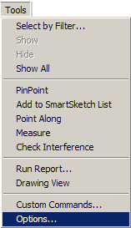
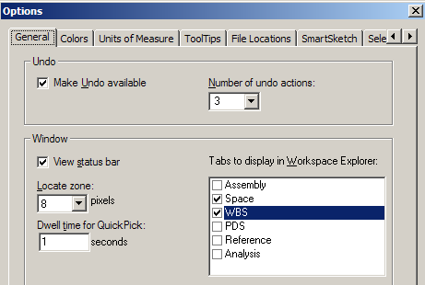
General Options
Allows you to enable the Undo command and the status bar
The activation time of the quick pick tool
Define the locate zone for SmartSketch
Define the Tabs to display in the Workspace Explorer

Slide 14
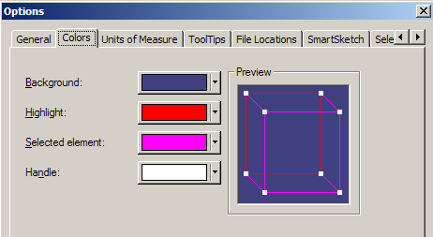
Colors Options
Allows you to select the colors the system uses for the background, Highlight and selected elements

Slide 15
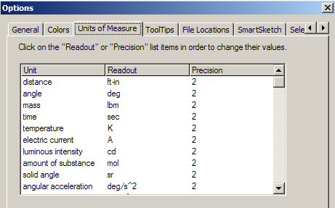
Units of Measure Options
Sets the display units
Sets the precision of the units
Everything stored in SI units in database
Units can be added to any keyed in input values
Example:
Slope: in / ft
Distance: in (fractional)

Slide 16
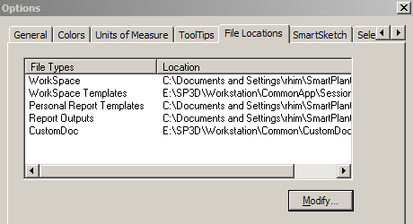
File Locations Options
File Locations

Slide 17
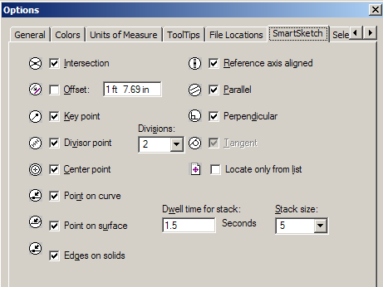
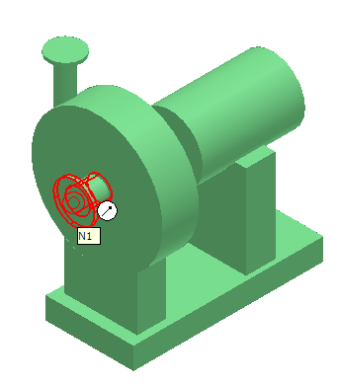
SmartSketch Options
Allows you to enable the smartsketch indicators

Slide 18
View Manipulation
Common Views
Zoom Tool
Window Area
Refresh View
Active View Control
Rotate View
Looking at Surface
View by 3 points
View along line
Clipping

Slide 19
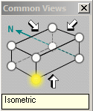
View Manipulation
Common Environment Toolbar
Common Views
Common views command allow you quickly change the view orientation to any standard isometric/orthogonal orientation

Slide 20
View Manipulation
Common Environment Toolbar
Zoom Tool
Pan
Zoom Area
  Zoom Tool command:
- Zoom in (mouse roller ball)
- Zoom out (mouse roller ball)
- Zoom Area (left mouse click, drag and release)
- Pan (Left mouse drag)

Slide 21
View Manipulation
Common Environment Toolbar
Fit
  Fit View command:
  Fit all visible objects within the current clipping volume in the Active View
  If objects are selected, then the command will fit only the selected objects

Slide 22
View Manipulation
Common Environment Toolbar
Refresh
  Refresh command:
  Update your workspace definition (filter) in the Active View

Slide 23
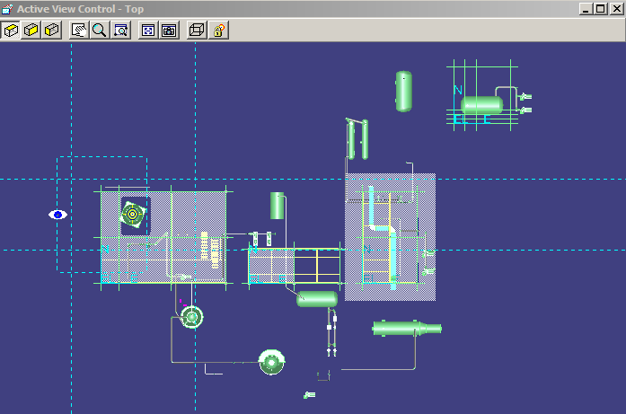
View Manipulation
Common Environment Toolbar
Active View Control
  Active View control command:
  Provides commands to dynamically control the view parameters of the active view

Slide 24
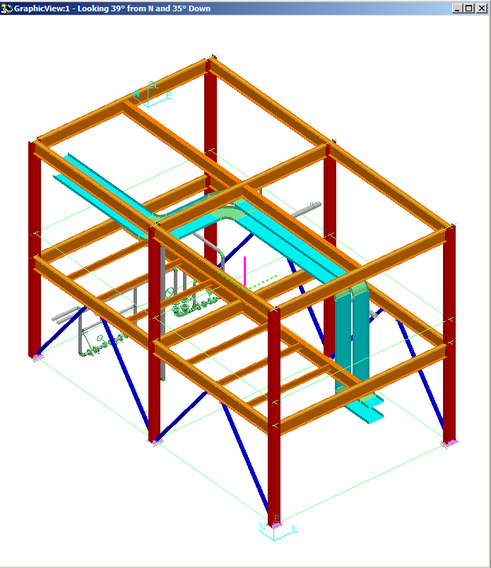
View Manipulation
Common Environment Toolbar
Rotate View
  Rotate View command:
  - Rotate the view interactively
  - Change the rotation axis
  - Change the rotation point

Slide 25
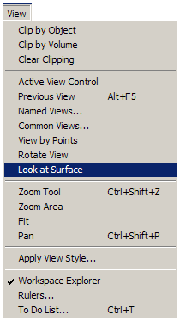
View Manipulation
  Look at Surface command:
  Rotate the active view planar to the
  selected surface

Slide 26
View Manipulation
  Establishing Clipping Volume
  - Clipping by Object
  - Clipping by Volume
  - Clear Clipping

Slide 27
View Manipulation
Common Environment Toolbar
Clip by Object
  Clip by Object command:
  Allows you to define the view clipping volume (rectangular parallopiped) to be the same as the object’s range box in your active view

Slide 28

View Manipulation
Smartstep ribbon bar
Clip by Object
Accept
Select Object
Select View
Reject
  A command step is also provided to assign the same clipping volume to additional views
  Use the Shift key to select multiple objects

Slide 29
View Manipulation
Common Environment Toolbar
Clip by Volume
  Clip by Volume command:
  Allows you to set the view clipping volume so that all objects not inside the clipped area are hidden from the selected view

Slide 30

View Manipulation
Drag Clipping planes
Smartstep ribbon bar
Select View
Clip by Volume
First point
Second point
Third point
Four point

Slide 31
View Manipulation
Common Environment Toolbar
Clear Clipping
  Clear Clipping command:
  Remove the clipping volume.
  It then prompts for select of the next window to clear
  The command is terminated by:
  - Right mouse click
  - Esc Key
  - Pick of another command

Slide 32
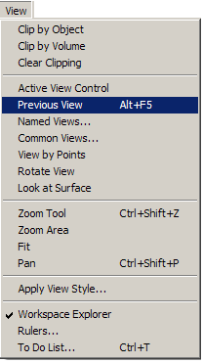
View Manipulation
Main Menu
  Restore the Previous View

Slide 33
View Manipulation
Common Environment Toolbar
Named View
Recall Views
  Saved View (Named View) command
  You can save the settings (location, orientation) of the active view so that you can apply them again later
  Recall views from the pull down on the command, four standard views supplied.

Slide 34
View Manipulation
Common Environment Toolbar
View by 3 pts
View along line
View by pts
View by 3 Points
  - Lets you pick the 3 Points that define a plane
  - The plane of your screen is the plane defined above
View along line
  - Lets you pick the two points along a line.
  - The plane of your screen is the plane perpendicular to above line

Slide 35
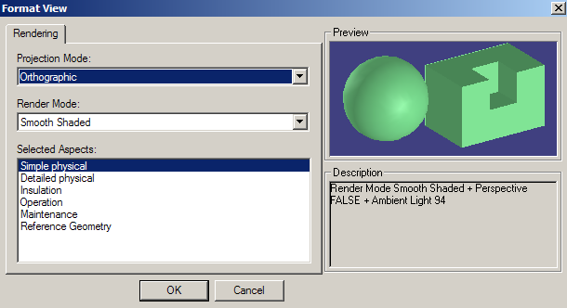

Formatting the Active View
You can format a View by defining a render mode and perspective setting
Render mode: Outline, Smooth Shaded and Shaded with Enhanced Edges
Aspect is a geometric representation for an object

Slide 36
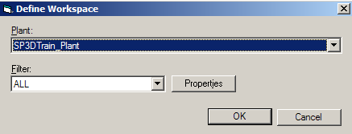
Workspace
  Define Workspace Command - (Ctrl +W)
Select the model database
Edit Existing Filter
Select or create new filter

Slide 37
Filters
A filter is a set of search criteria that selects or retrieves data based on the
object properties:
  System
  Assembly
  Named Space
  Work Breakdown Structure (WBS)
  Analysis
  Permission group
  Object Type
  Spatial (Volume)
  Reference
  Properties
  PDS (If PDS project attached)
DB2
DB1
DB3
Workspace
See only the data you want to see.

Slide 38
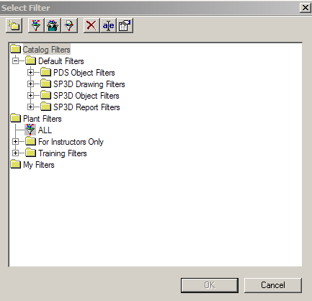
Filters
  Catalog Filters are filters which are stored in the catalog and are available to all users that use the same catalog
  Plant Filters are filters available to all users in a model. These filters are stored in the model database
  My Filters are created by the user and are only visible to him. These filters are stored in the model database
Catalog Filters
Plant
Filters
My
Filters

Slide 39
Filters
Compound
Filter
Simple
Filter
SQL
Filter
Simple Filters
Simple Filter is a query based on the object properties defined through GUI
Compound Filters
A “Compound” filter is two or more filters with an operator between them.
SQL Filters
Is a filter which provides a place to store user-written SQL query
Asking Filters
Is a filter that has left specific values for certain properties as variables to be filled in by the user when user uses the filter

Slide 40
Filters
Rename
Delete
  New Folder
  New Filter (Simple or Asking)
  New Compound Filter
  New SQL Filter
  Delete
  Rename
  Properties
Properties
Folder

Slide 41
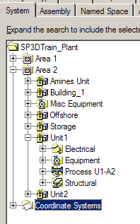

Filter Properties
System Tab
Expand the search to include all selected systems
  A system is a way to group objects logically – e.g. by discipline, by design area, by physical area, etc
  Every object must belong to a system
  System Types

Slide 42
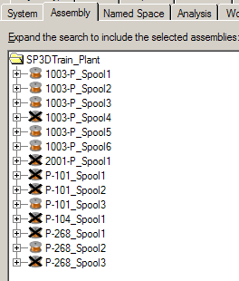
Filter Properties
Assembly Tab
Expand the search to include all selected assemblies
Example of assemblies are:
  Spools
  Hangers and Supports

Slide 43
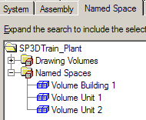
Filter Properties
Named Space Tab
Expand the search to include all selected named spaces
  A space is a way to define a relationship between the functional requirements of a space area in a model and it real geometrical position

Slide 44
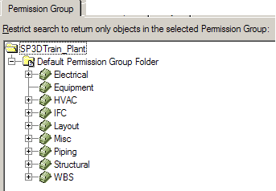
Filter Properties
Permission Group Tab
Restrict the search to return only objects in the selected permission group
  Every object must belong to a permission group.
  The permissions for the objects in model are defined by a set of Access Control Rule:
    Read – Can view objects
    Write – Can create/modify/delete objects
    Full Control – Can perform all operations on objects

Slide 45
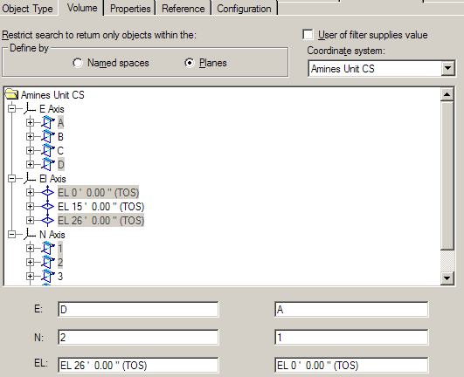
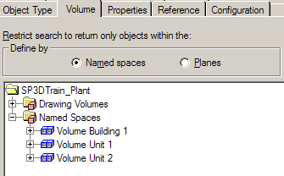
Filter Properties
Volume Tab
Restrict the search to return only objects within the volume

Slide 46
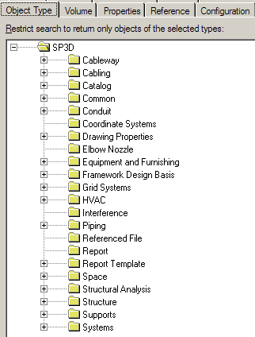
Filter Properties
Object Class Tab
Restrict the search to return only objects of the selected types

Slide 47
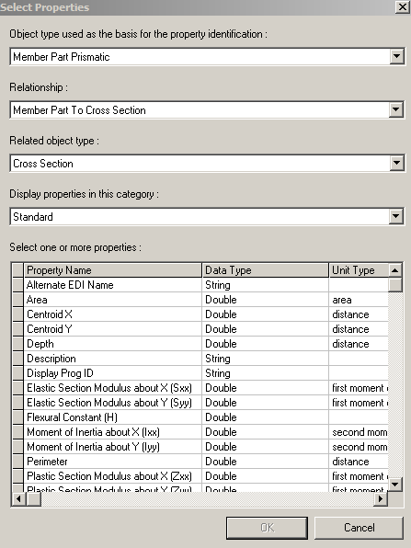
Filter Properties
Properties Tab
Restrict the search to return only objects matching the selected properties
  Select the basis object for which properties are being located
  Select the relationship that the basis object supports
  Select the related object for which properties are being located

Slide 48
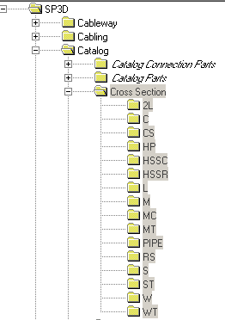
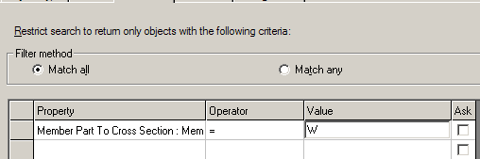
Filter Properties
Properties Tab
Query objects based on Cross Section

Slide 49
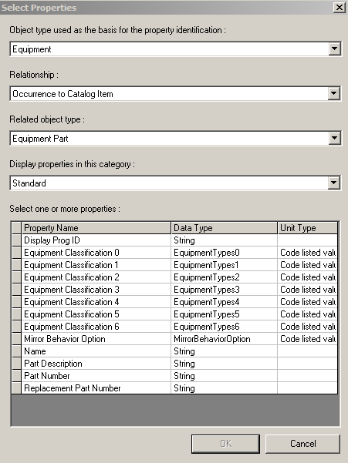
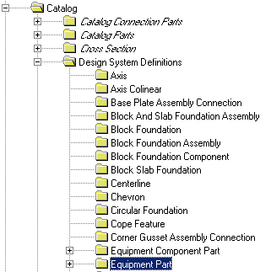

Filter Properties
Properties Tab
Query objects based on Equipment Types

Slide 50
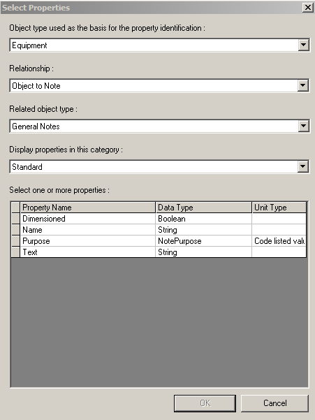
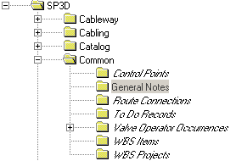

Filter Properties
Properties Tab
Query objects based on General Notes

Slide 51
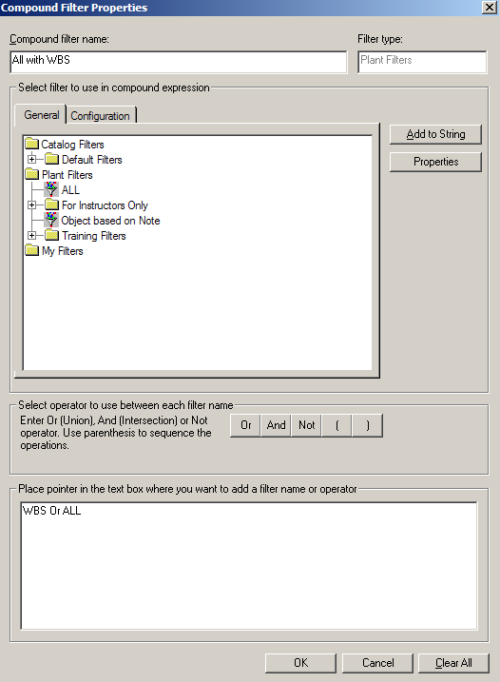
Compound Filters
  Display Properties of each filter used in the compound query by selecting the individual filter name and then clicking the Properties button
  An AND of two filters results in only those objects that the two filters had in common.
  A OR of two filters results in getting together the list of objects from both filters.
  A NOT operator on a filter results in a list of objects opposite to the selected filter return.
  Show the Compound Query string in a text box

Slide 52
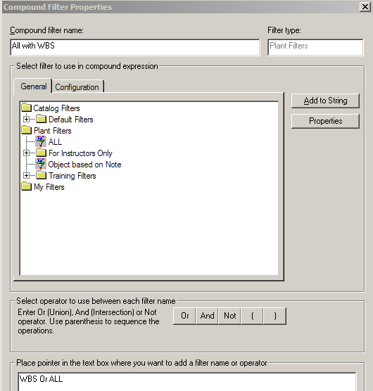
Compound Filters
Example:
This query returns all model objects
and WBS objects
All model objects
+ WBS objects
All Model objects
Filter 1
All WBS objects
Filter 2

Slide 53
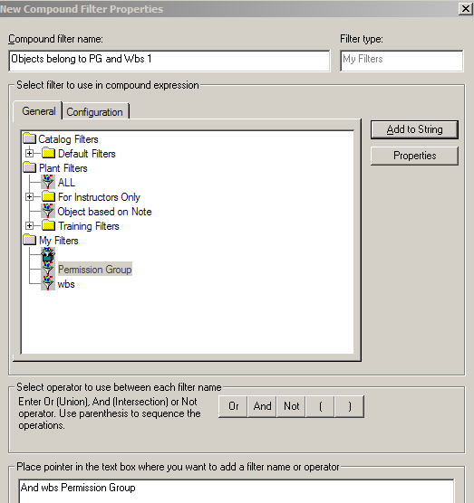
Compound Filters
Example:
This query returns only those objects
that belong to permission group 1
and assigned to WBS Contract 1
Compound Filter
Permission
Group 1
Filter 1
Objects in
WBS Contract 1
Filter2

Slide 54
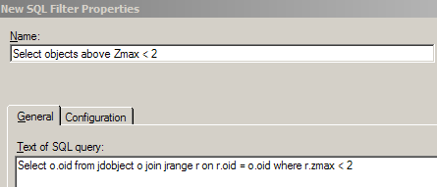
SQL Filters
  SQL (Handwritten Query) Filter Properties Dialog
  Key in the SQL text statements
  Select o.oid from jdobject o join jrange r on r.oid = o.oid where r.zmax < 2
Notes:
Select o.oid from jdobject o join jrange r on r.oid = o.oid where r.zmax < 2

Slide 55

Asking Filters
Using a Parameterized “Asking” Filter
When the creator of a filter checked any “User of filter supplies value”
checkboxes, then that filter is an “Asking” or “Parameterized” Filter. When
someone uses that filter, automatically the properties page for that filter is
displayed with the “User of filter supplies value” checkboxes as read-only,
but the gadgets to set the values (associated with the checked “User of filter
supplies value” checkboxes) are displayed so that the user can edit only the
values of the checked items. If a compound filter uses multiple
Parameterized Filters, let the Properties dialogs appear sequentially,
automatically, in the same order that the parameterized filters appear in the
compound query string.
Notes:
Select o.oid from jdobject o join jrange r on r.oid = o.oid where r.zmax < 2

Slide 56
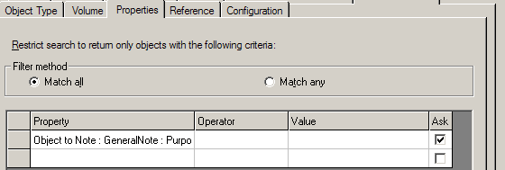
Asking Filters
Using a Parameterized “Asking” Filter
Notes:
Select o.oid from jdobject o join jrange r on r.oid = o.oid where r.zmax < 2

Slide 57
Filters
Managing Filter Names when Copy Filters
  - Users can copy and paste or move filters via drag and drop to a different category directory in the Select Filter dialog’s tree view
  - Filters in My Filters folder can have the same name as Filters in someone else’s My Filters Folder. If the filter is moved up to a Plant Filter or Catalog Filter folder, then the software must check whether there is already a filter by the same name and change the name of the cloned filter to “<filter name> n” where n is some number so that the name of the filter is unique
  - Compound Filters are made up of AND, OR and Not operators between existing filters. A Compound Filter that will be stored in the Catalog must be made from other filters that are already existing in the Catalog
Notes:
Select o.oid from jdobject o join jrange r on r.oid = o.oid where r.zmax < 2

Slide 58
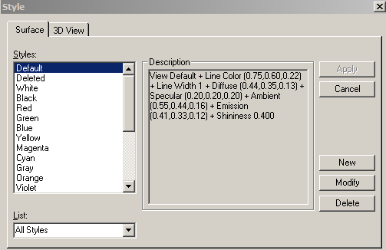
Applying Styles
Styles are collections of color, lighting, and render modes that you can apply to all views or to specific items in the views. New user styles are stored in the database
  - View Style
  - Surfaces Style
All Styles
Or
Styles used in workspaces
Notes:
Select o.oid from jdobject o join jrange r on r.oid = o.oid where r.zmax < 2

Slide 59
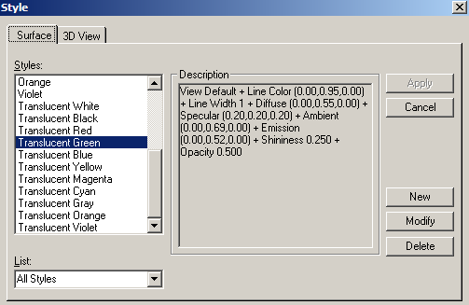
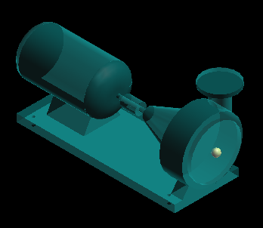
Applying Surface Style
  to Selected objects
  Using surface style rules
Translucent
Green
Notes:
Select o.oid from jdobject o join jrange r on r.oid = o.oid where r.zmax < 2

Slide 60
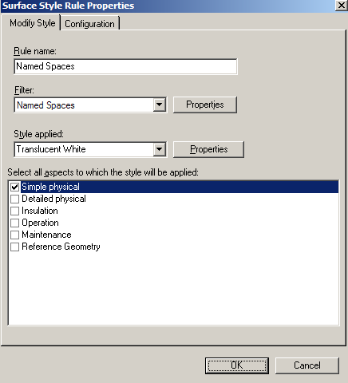
Applying Surface Style
  A Surface Style Rule consists of a filter and the named surface style to be applied to the specific aspects of the objects identified by the filter
Notes:
Select o.oid from jdobject o join jrange r on r.oid = o.oid where r.zmax < 2

Slide 61
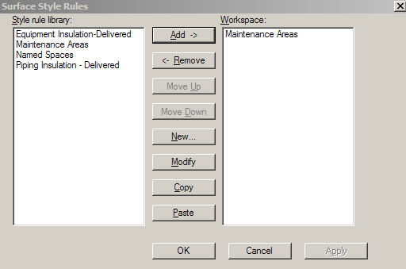
Applying Surface Style
  Surface style Rules is saved in the model database
  Surface style rule applied to the workspace is saved in the session file
  Copy/Paste functionality
Notes:
Select o.oid from jdobject o join jrange r on r.oid = o.oid where r.zmax < 2

Slide 62
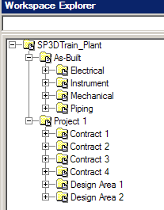
Work Breakdown Structure
  Hierarchy to handle Projects
  The Project object serves as a grouping function for both As-Built and Projects
    Create WBS Command
    Claim Command
    Release Claim Command
Notes:
Select o.oid from jdobject o join jrange r on r.oid = o.oid where r.zmax < 2

Slide 63
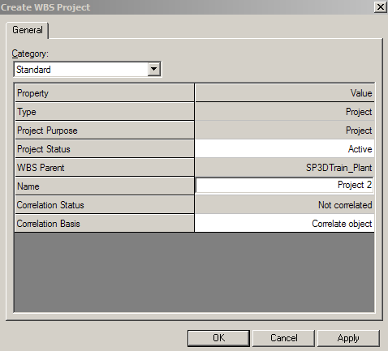
Work Breakdown Structure
Project Status: Enumerated
  Created
  Active
  Started Completion
  Completed
  Merged
  Finished
  Cancelled
  Terminated
Notes:
Select o.oid from jdobject o join jrange r on r.oid = o.oid where r.zmax < 2

Slide 64
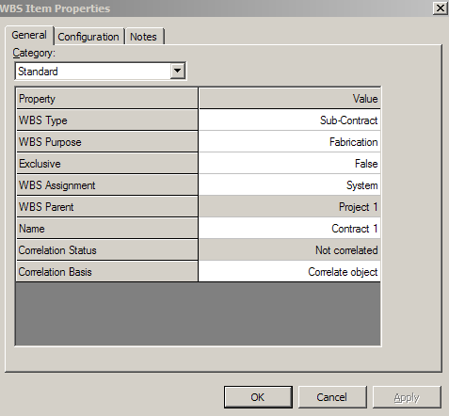

Work Breakdown Structure
WBS Item (Type)
Notes:
Select o.oid from jdobject o join jrange r on r.oid = o.oid where r.zmax < 2

Slide 65
Work Breakdown Structure
WBS edit ribbon bar
  Setting
  Select Related Object
  Deselect All
  Finish
  Purpose
  Name
  WBS Parent
Notes:
Select o.oid from jdobject o join jrange r on r.oid = o.oid where r.zmax < 2

Slide 66

ToolTips
Label Editor
Allows to edit labels in an easy way using common User Interface
The edited label is saved in the model DB
Notes:
Select o.oid from jdobject o join jrange r on r.oid = o.oid where r.zmax < 2

Slide 67


ToolTips
Notes:
Select o.oid from jdobject o join jrange r on r.oid = o.oid where r.zmax < 2

Slide 68
Select Objects
  Select Command
  By Fence (inside or overlap control)
  Use shift key to add or remove objects from the select set.
  Tools -> Select by Filter
  Use Workspace Navigator
  Quick pick tool
Notes:
Select o.oid from jdobject o join jrange r on r.oid = o.oid where r.zmax < 2

Slide 69

Hide/Show command
Hidden objects are displayed in Italic Text
Notes:
Select o.oid from jdobject o join jrange r on r.oid = o.oid where r.zmax < 2

Slide 70

SmartSketch
SmartSketch is the mechanism to automatically find special points when the command is looking for a point.
Notes:
Select o.oid from jdobject o join jrange r on r.oid = o.oid where r.zmax < 2

Slide 71
SmartSketch Options
Allows you to enable the smartsketch indicators

Slide 72

SmartSketch
  The system finds Key point and Point on Geometry whenever you move the
  cursor over those points
  System uses only those points (stored in the stack) and check for linear
  relationship points against every object in the workspace
Notes:
Select o.oid from jdobject o join jrange r on r.oid = o.oid where r.zmax < 2

Slide 73
SmartSketch
User will have two options on what objects are located by SmartSketch
- Locate on Display List
- Locate on List Only
SmartSketch Lock Constraint
When SmartSketch is being used, a middle mouse click will lock the currently active smartsketch constraint.
- Middle mouse button
- Ctrl –L keys
Notes:
Select o.oid from jdobject o join jrange r on r.oid = o.oid where r.zmax < 2

Slide 74

SmartSketch
User will have two options on what objects are located by SmartSketch
- Locate on Display List
- Locate on List Only
Clear Stack
Set Stack Size
Locate List
Toggle Display/List Only
Set Dwell Time
Notes:
Select o.oid from jdobject o join jrange r on r.oid = o.oid where r.zmax < 2

Slide 75

Control Points
  Definition
  A 3D object representing a point in the model
  Drive label locations on orthographic drawings
  Placement method:
    Insert Control Point Command
    Define in the Symbol Definition
  Control point location is user defined
  The position can be declared to be at a fixed global position or the positioning method can be associatively maintained.
  The control point is associative to a parent object
  Control Point graphics is a sphere that does not support interference detection
  Control Point is displayed in Reference Geometry Aspect
Control Point
Notes:
Select o.oid from jdobject o join jrange r on r.oid = o.oid where r.zmax < 2

Slide 76

Control Points
Properties
Parent Object
Point Location
Type
Sub Type
Name
Notes:
Select o.oid from jdobject o join jrange r on r.oid = o.oid where r.zmax < 2

Slide 77
Measure
  Tool -> Measure
  Measure Actual or Minimum 3D linear distance between two points
  Measure delta E, N, EL distance between two points
  Measure actual angle defined by three points
  Measure radius and diameters
Measure Min Distance between objects
Measure angle between objects
Measure Rad / Dia
Define coord system
Set active Coordinate System
Measure angle between 3 points
Measure Min
Distance between points
Measure Distance along object
Displays
Relevant Data
Notes:
Select o.oid from jdobject o join jrange r on r.oid = o.oid where r.zmax < 2

Slide 78
Checking Interferences
  SP3D provides two mode of operations:
  Server-based Interference checking (Database Detect).
  - Run on a separate IFC server
  - Look for all interferences for the full model
  Interactive interference checking (Local Detect).
  - Help the designer in real time
  - Local to a session (what you see in your workspace)
Notes:
Select o.oid from jdobject o join jrange r on r.oid = o.oid where r.zmax < 2

Slide 79
Checking Interferences
  Major Differences between the two methods:
Database Detect | Local Detect
Runs all the time (System Admin. choice) | Works only within the current session
Minimizes impact on users and improves performance | Provides immediate graphical feedback (works in a dynamic mode)
Creates persistent interferences that are stored in the model database | Shows interferences when the pointer is idle for a brief amount of time; based on a hesitation approach
Based on administrator settings (controlled by permission groups) | Based on individual user settings
Provides feed back on how much has been checked | Checks only created and modified items
Users can visualize the interferences (persistent items) | Clears dynamic interferences after refreshing workspace

Slide 80


Checking Interferences
IFC is available in all Task
Very simple and intuitive GUI
Ribbon bar includes:
  Settings
  Visualization
  Review & Approval

Slide 81
Checking Interferences
Three type of checking (based on the object aspects):
  Required
  Optional
  Not Checked
Can process:
  Required – Required
  Required – Optional
  Optional – Optional
A clearance rule can be used

Slide 82
Checking Interferences
  Check Interference ribbon bar
Required Action
Show
Hide
Fit
List

Slide 83

Checking Interferences
  Any persistent interference detected by the Database Detect process appears as a sphere
  Interference detected by the Local Detect process appears as a box
Local Detect
Database Detect

Slide 84
Checking Interferences
  Interference List Dialog Box
    Resizable
    Can Sort the listed interferences
    Highlight an interference in the workspace
    Right click to open the Interference properties dialog

Slide 85


To Do List
    An object’s relationship with another object become inappropriate, the system generate an Error entry in the To Do List.
    A relationship has changed between to object, but the person who modified the objects only have write access to one of the object. The system generate an Out of Date entry in the To Do List

